Slide 1
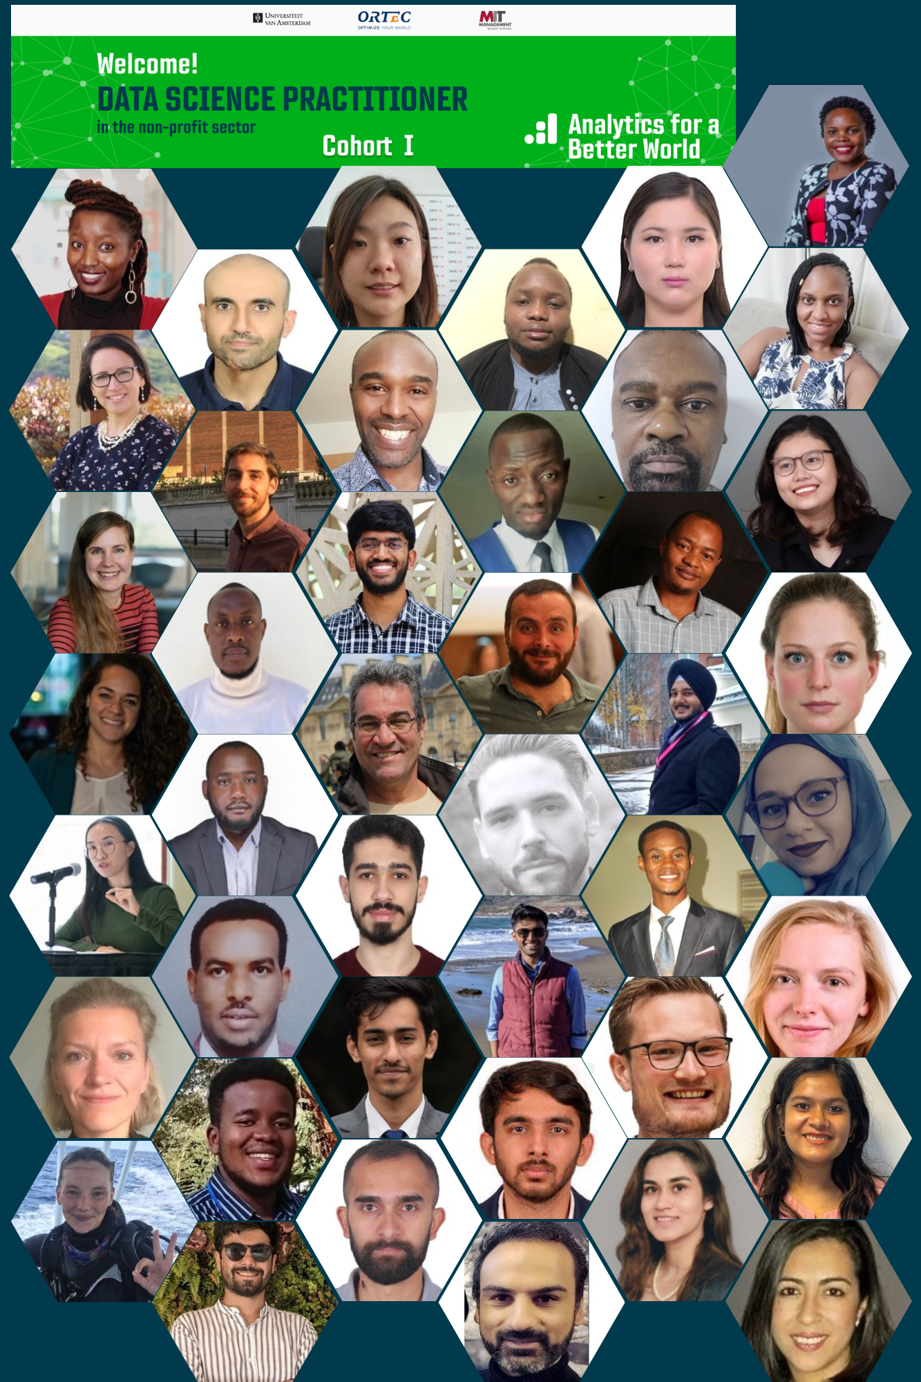
Data Science Practitioner
Fellowship Cohort 2022
Final Project Presentations – 6th December 2022
Resilience Map
Frank Thomas, WFP Tanzania

Slide 2

Resilience Map
WFP Tanzania
Mapping entire resilience programme by WFP in Tanzania. Locating existing site and identifying locations for new resilience programme sites.
This Resilience map project seek to generate visual data for informing the needs for assets creation in the area.

Slide 3
Business Case
How can WFP Tanzania pricely locate assets?
The resilience project by WFP Tanzania involves creation, rehabilitation and/upgrading of community assets that reduce the food-related impact of drought risk, strengthen livelihoods, and build resilience such as irrigation canals, water ducts, water intake points as well as domestic and livestock water points in the regions of Dodoma, Singida and Simiyu.
Efficient location of the assets play significant roles for success of the resilience project and therefore sustainability. This Resilience map project seek to generate visual data for informing the needs for assets creation in the areas and determine location for the new assets to be developed.
With available funding the scope mission was done to determine areas of start for the resilience project and few districts from Dodoma were selected. The selected districts includes Kongwa, Kondoa and Mpwapwa all in Dodoma.
The focus for this Resilience map project is Kongwa district, located in Dodoma. Dodoma is the capital city of Tanzania. The 2022 Census estimate 3.08 million people lives in Dodoma that is equivalent to 5% of country population.
Kongwa district is one of the 7 districts in Dodoma region with 22 wards (admin level 3) administrative division. Having a population of approximately 300,000

Slide 4
Methods or Tools Used
Development of the resilience map uses existing data and recently obtained drone data.
Drone data is processed using ArGIS, Google earth pro and Tableau.
To determine areas of priority images of existing household and public infrastructure and open space for agriculture will be considered.
Other methods that will be used include analysis of the vegetation (NDVI-Normalized Difference Vegetation Index)

Slide 5
Most Significant Change (can be a forecast)
The result of the project will enable putting focus on areas with higher demand for fundraising and therefore enabling achievement of SDG 2 through increase of productive land (access to irrigation canals)
SDG 2: End hunger, achieve food security and improved nutrition and promote sustainable agriculture
Target 2.4: By 2030, ensure sustainable food production systems and implement resilient agricultural practices that increase productivity and production, that help maintain ecosystems, that strengthen capacity for adaptation to climate change, extreme weather, drought, flooding and other disasters and that progressively improve land and soil quality
Indicator 2.4.1: Proportion of agricultural area under productive and sustainable agriculture
Notes:
Describe here the Most Significant Change (impact) you expect after implementing the project, on:
The work you do
Your Organization
The Sustainable Development Goals

Slide 6
Key Learnings
Notes:
Mention here your Key Learnings

Slide 7
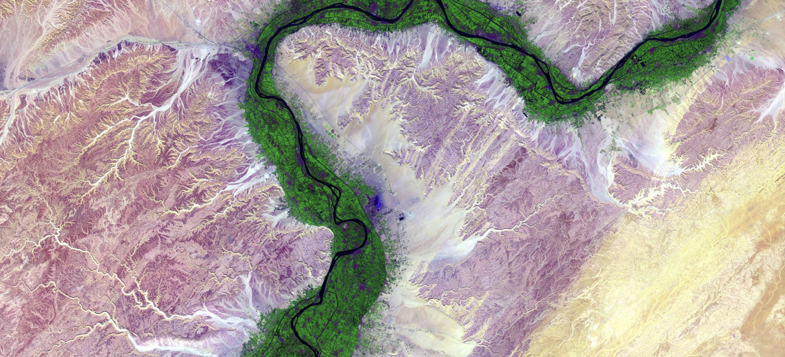
Thank you for your attention!
https://analyticsbw.org/
https://www.linkedin.com/company/analytics-for-a-better-world/
academy@analyticsbetterworld.org

